Slide 1
2018 Examination Results

Slide 2
Level 3 Results

Slide 3
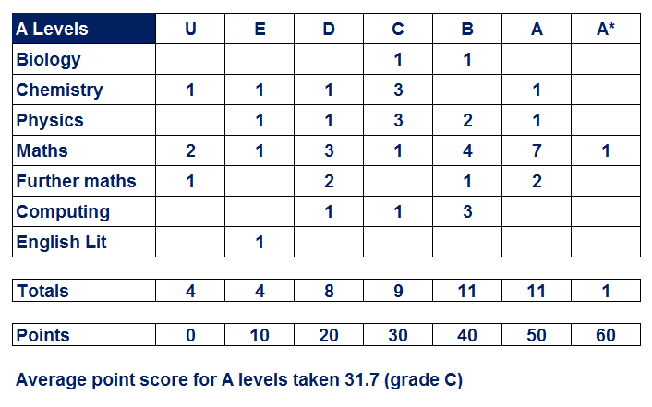
The Redborne School data team (independent analysts) calculate that the A Level value added score would be +0.33 (based on 2017 benchmarks).
National and regional data not yet available for 2018 but, if results are the same as last year, this would still put us at the top with the best progress score in all Lincolnshire (albeit with a narrower margin).

Slide 4
100% success rate for our Level 3 engineering students (triple and single award)
No students on pass grades … all achieving merit or better
70% achieving distinction grades
All the students on the single award (3 students) achieved distinction *

Slide 5
Level 2 Results

Slide 6
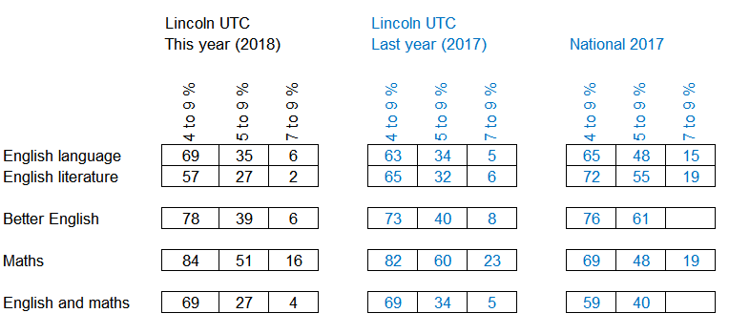
Attainment in English and maths significantly ahead of national average at the 4 to 9 threshold
Attainment in English and maths below national average at the 5 to 9 threshold (due to low numbers achieving the higher grades in English)
Maths results very strong in every respect

Slide 7
Key Stage 2 to Key Stage 4 Progress

Slide 8
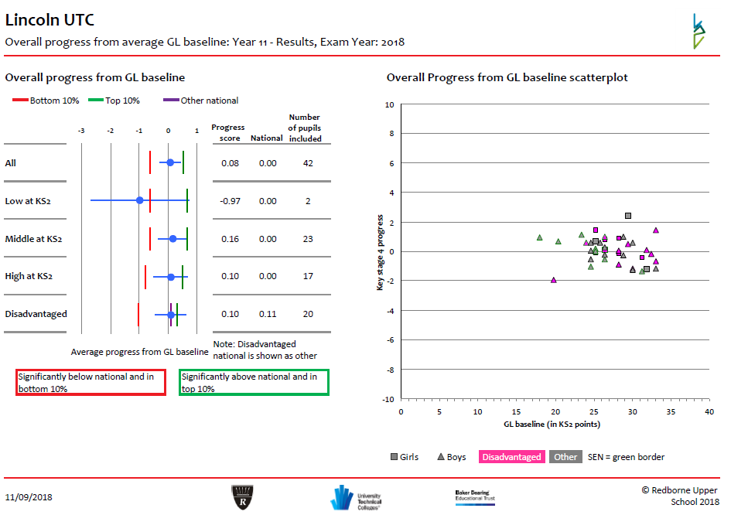
Key Stage 3 to Key Stage 4 Progress
The Redborne School data team (independent analysts) calculate that the KS3 to KS4 progress score is positive at +0.08
This calculation is based on the independent GL assessments done at the beginning of year 10.

Slide 9
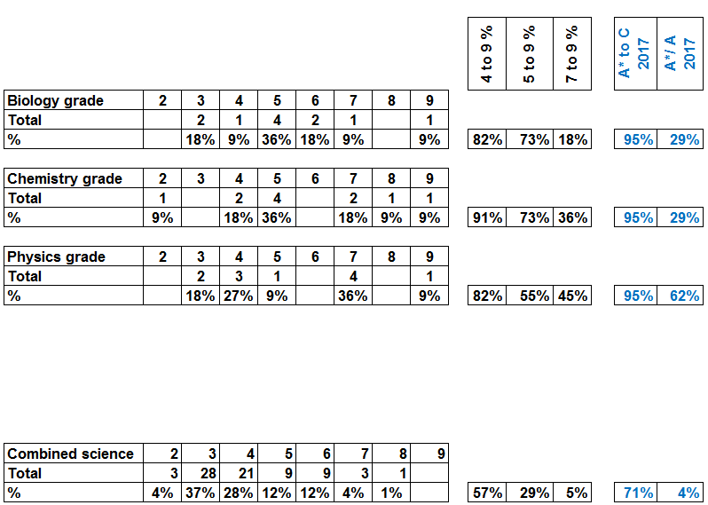

Slide 10
